Slide 1

Online Delivery Restaurants

Slide 2

Spreadsheet Project:
Zomato Restaurants Analysis

Slide 3

Agenda
Problem Statement
Data Description
Objective Key Metrics and Visualizations
Subjective Question for Insights

Slide 4
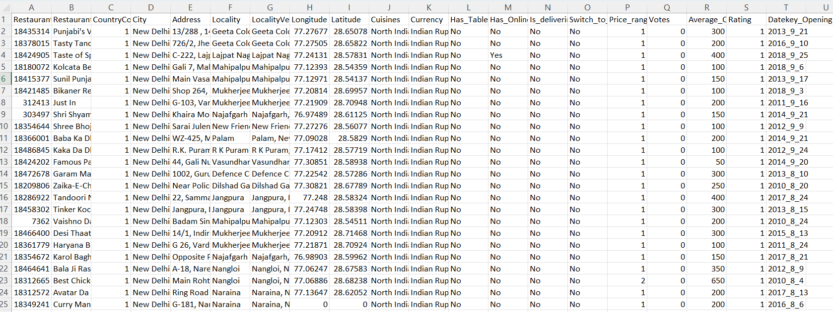
Problem Statement
You are hired as a consultant data analyst by zomato where the team is looking for expansion and opening more restaurants. Your task is to come up with strategies/suggestions about opening newer restaurants.

Slide 5
The image above displays details about Zomato Sales Performance, including:
Restaurant ID: Unique identifier for each restaurant.
Restaurant Name: The name of the restaurant.
CountryCode: Country code of the location where the restaurant is situated.
City: The city where the restaurant is located.
Address: The specific address of the restaurant.
Locality: The locality or neighborhood where the restaurant is situated.
Locality Verbose: Detailed information about the locality.
Longitude: The geographical longitude coordinate of the restaurant.
Latitude: The geographical latitude coordinate of the restaurant.
Cuisines: The type of cuisine offered by the restaurant.
Currency: The currency used for transactions in the restaurant.
Has_Table_booking: Indicates whether the restaurant has a table booking option (Yes/No).
Has_Online_delivery: Indicates whether the restaurant offers online delivery (Yes/No).
Is_delivering_now: Indicates whether the restaurant is currently delivering (Yes/No).
Switch_to_order_menu: Indicates whether users can switch to the order menu (Yes/No).
Price_range: A numeric value indicating the price range category of the restaurant.
Votes: The number of votes or ratings/(feedback) received by the restaurant.
Average_Cost_for_two: The average cost for two people dining at the restaurant.
Rating: The overall rating of the restaurant is based on user reviews.
Datekey_opening: The date when the restaurant was opened.

Slide 6

Use this Link for copying and then manipulating the dataset.

Slide 7
Submission
There is a series of tasks/questions mentioned ahead in the Project, in order to guide the candidates to have suggestions, insights for the management.
Imagine you have to present the submitted PPT file to the senior management using which you are giving the suggestions as per the requirement with the reasoning/help of dashboard, visualizations or tables you’ve created.
The submission Zip file should consist of the following three documents:
Excel File (.xlsx) (consisting of dashboard)
Document File (.docx) (consisting of Answers and suggestions for Objective and subjective questions)
Presentation File (.pptx) (consisting of the presentation which you want to present to the management)

Slide 8
Tasks
…Tasks in order to come up with expansion suggestions

Slide 9
Objective Questions
The data consists of some inconsistent and missing values so ensure that the data used for further analysis is cleaned.
Using the LookUp functions, fill up the countries in the original data using the country code.
Create a table to represent the number of restaurants opened in each country.
Also the management wants to look at the number of restaurants opened in each year, so provide them with something here.
What is the total number of restaurants in India which are in the price range 4?
What is the average number of voters for the restaurants in each country according to the data?

Slide 10
In order to answer the next data analysis questions you will have to create Dashboards and visualizations (Can choose few pivot tables as well ).
For answering these questions you need to properly analyze the data through summarization, dashboard and visualizations to give the insights. Back your suggestions/insights with proper reasoning considering the data.

Slide 11
Data Analysis and Visualizations
Suggest few countries where the team can open newer restaurants with lesser competition. Which visualization/technique will you use here in order to justify the suggestions?
Come up with the names of States and cities in the suggested countries suitable for opening restaurants.
Name the chart/spreadsheet function you will use for solving the problem?
According to the countries you suggested, what is current quality in terms of ratings for restaurants that are opened there?
Will you use any aggregation function or a visualization here to solve the problem?
Also what is the current expenditure on the food in the suggested countries, so that we can keep our financial expenditure in control? Mention the functionality which you will use for giving the suggestions, will it be any aggregated function or a visualization?

Slide 12
Data Analysis and Visualizations
Come up with the names of restaurants from the recommended states who are our biggest competitors and also those which are rated in the lower brackets, i.e. 1-2 or 2-3.
How do you decide if anyone is a competitor?
Which cuisines should we focus in the newer restaurants to get better feedbacks? Does the choice of cuisines affect the restaurant ratings?
What is the basis for the suggestions? And mention how did you decide if the cuisines affect the ratings?
According to our current data, should we go for online delivery and table booking? Does that affect the customer’s ratings?
Mention your approach and spreadsheet function for the answer.
Should the team keep the rate of cuisines higher? Will that affect the feedback? According to our data are the rate of cuisines and ratings, correlated?
Back the suggestion with proper insights and visualization.

Slide 13
What is the distribution of number of restaurants of different price ranges in all the countries?
Distribution means the numbers of different price ranges, how will you show this using a chart?
Ensure that you put the slicers for choosing the country and year in order to observe the dashboard since the management will be having a long discussion which can go for weeks.
Note: The dashboard would be more interactive and user-friendly, allowing management to explore data in detail and make informed decisions.

Slide 14
SUBMISSION DEMONSTRATION
Refer to the video released in the batch

Slide 15
SUBMISSION FLOW
The candidates are supposed to submit the project within 10 days.
After the submission, candidates will receive the feedback on their project, which they are supposed to incorporate and re-submit.
All the candidates are supposed to get a total of 8 marks in order to be prioritized in placements. They are necessary in Placements.
The re-submissions after 3 weeks of launch in the batch will be de-prioritised while evaluations.
Candidates will have to give the reason for their delay, in order to make sure that team picks up their evaluation.
This will create backlogs as the project for next module will also be releasing around the same time.
So make sure to submit the project (with the requirements) within timeline.

Slide 16
GUIDELINES:
Ensure to submit the project within the deadline.
TA support won’t be answering any direct questions regarding project.
Plagiarism will be checked during evaluation.
Queries regarding submission should be asked to success champions.
Candidates must score >=8 out of 10 in order to be picked for referrals.

Slide 17
EVALUATION
All the components mentioned below hold significance while evaluation:
Excel File: (3 marks)
Data Cleaning
Dashboarding
Proper formatting
Correct choice of visualization charts
Doc File: (2 marks)
Exact answers to the objective questions
Proper answers to the subjective questions with reasoning
Proper formatting
Presentation File: (2 marks)
Proper storytelling
Proper formatting

Slide 18


